Slide 1
Epidemic Models:
Reed Frost Chain Binomial Change Point Estimation
Andre Ehrlich

Slide 2
Reed Frost Chain Binomial
Chain of Binomials
Discrete time process
Deterministic Infectious Period
Estimate Single Parameter q, the probability of individual infection

Slide 3
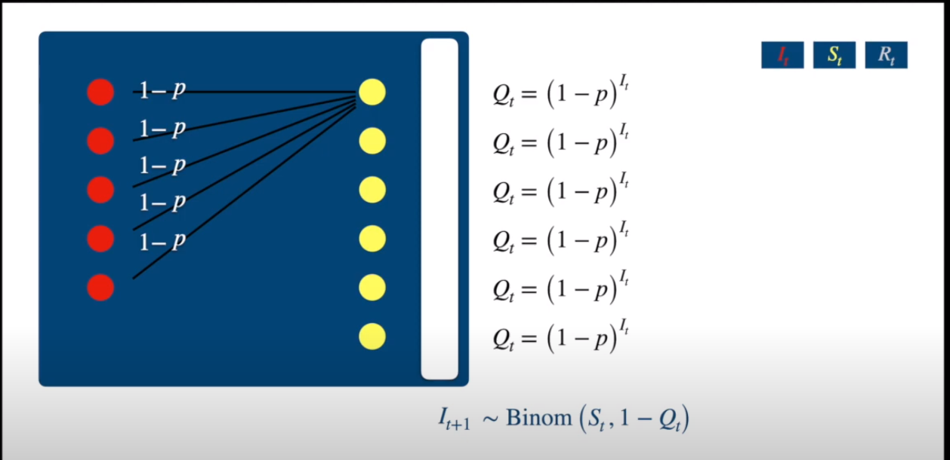
Reed Frost Chain Binomial
Source: quantpie

Slide 4
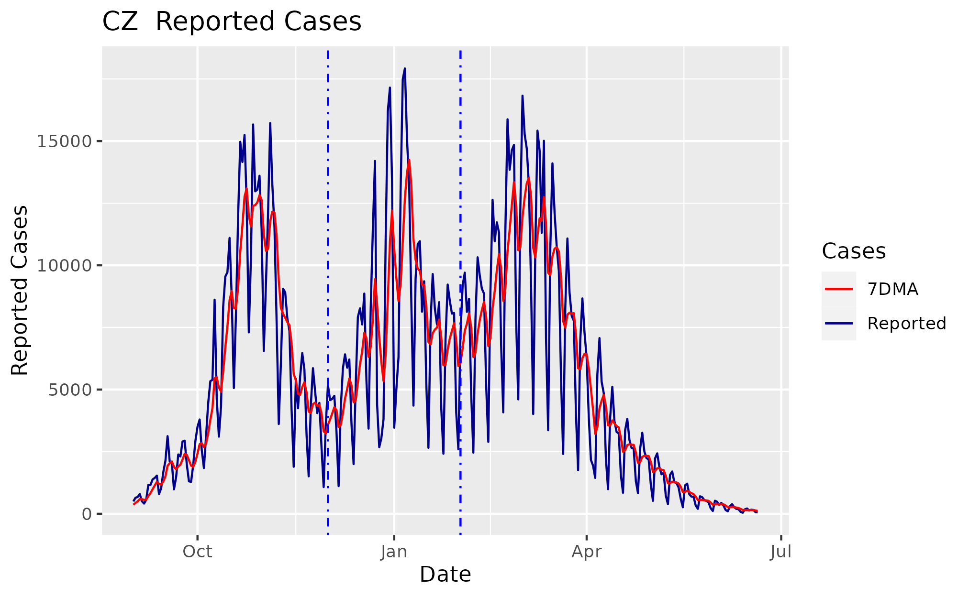
Czechia
Population: 10M
Max Cases: 15k
Intraweek Seasonality ??

Slide 5
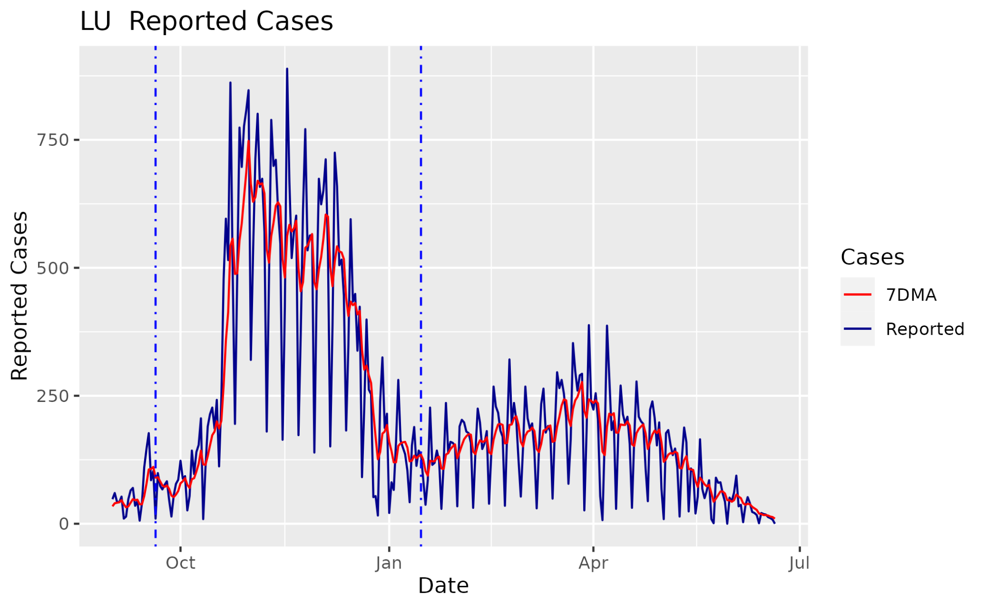
Luxemburg (LU)
Population: 0.6 M
Max Cases: 750

Slide 6
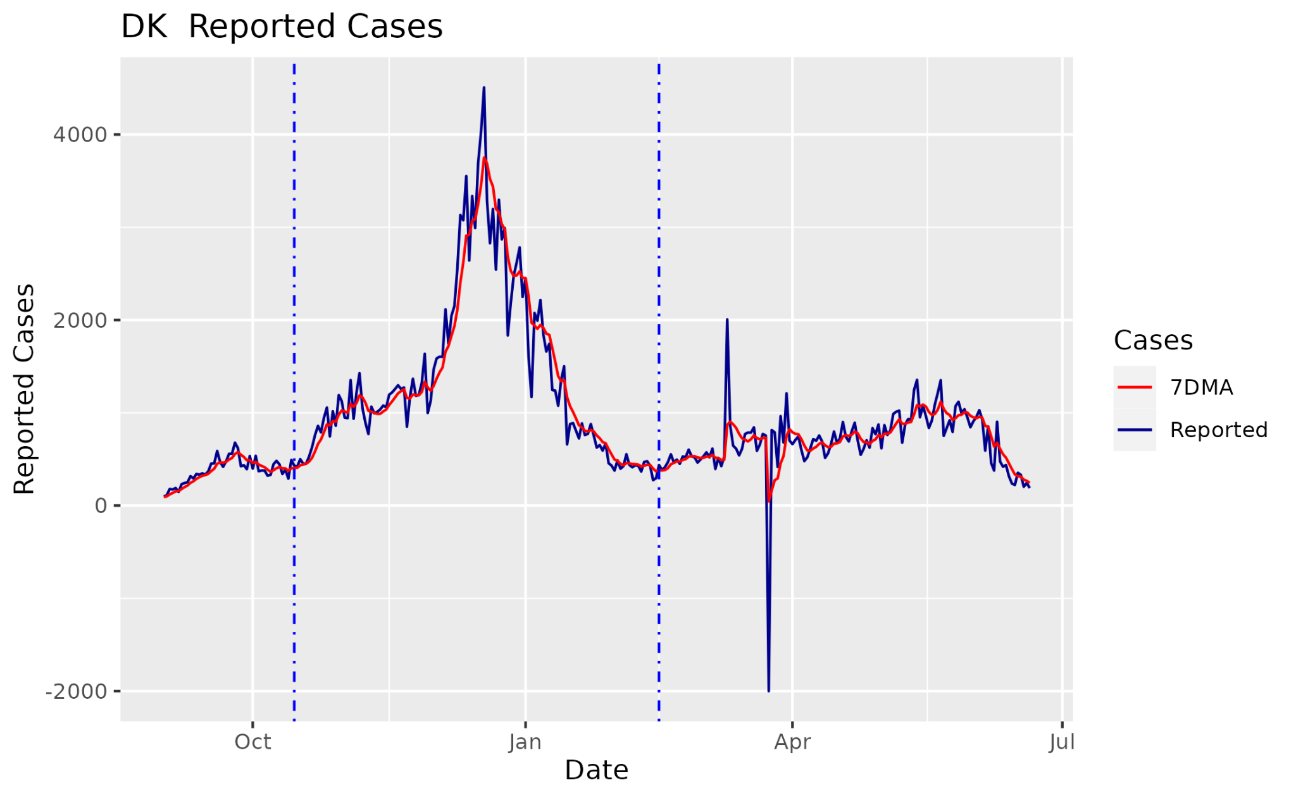
Denmark
Population: 5.8 M
Max Cases: 3.7k

Slide 7
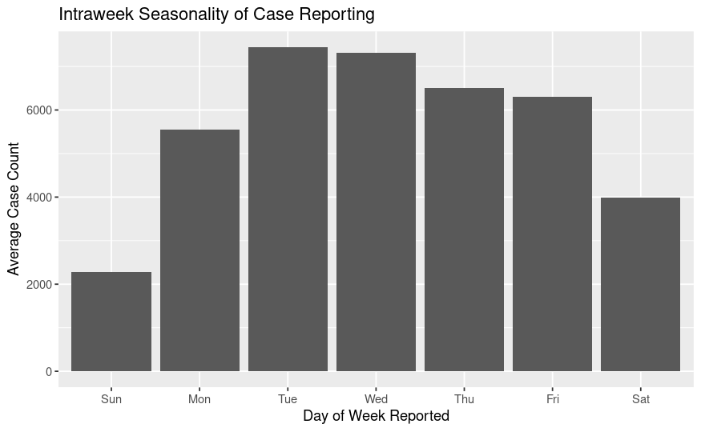
Global Seasonality

Slide 8
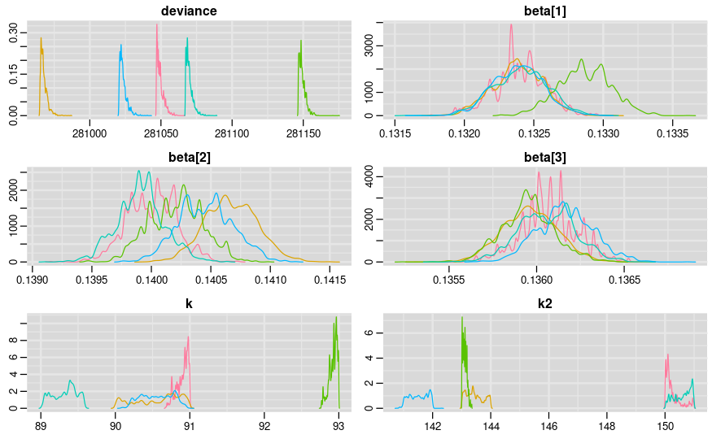
Czechia
Raw Reported Cases

Slide 9
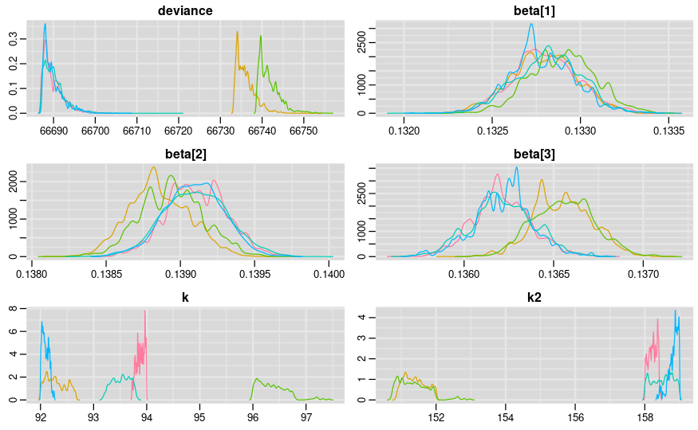
Czechia
7DMA Cases
Slightly better convergence ?

Slide 10
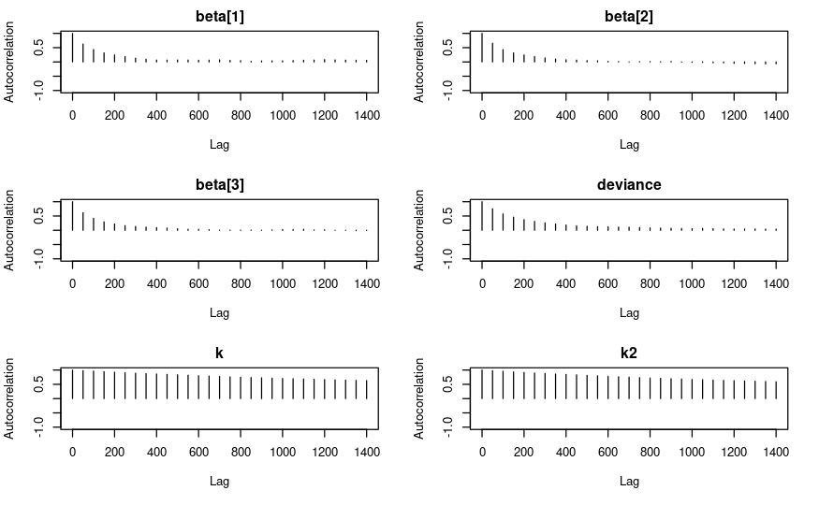
Czechia
Heavy Auto-Correlation
on k parameters

Slide 11
Country | # Change points | pD | DIC | Beta μ (σ) | Κ
CZ 7DMA | 0 | 1 | 67226 | 0.136 (0.0) | NA
 | 1 | 2 | 66979 | 0.133 (0.0) 0.137 (0.0) | k = 90
 | 2 | 3 | 66930 | 0.133 (0.0) 0.137 (0.0) 0.138 (0.0) | k = 90 K2 = 145
 | 2 (est) | -67.9 | 66640 | 0.132 (0.0) 0.136 (0.0) 0.139 (0.0) | k = 93.6(1.5) k2=155.6(3.5)

Slide 12
Luxemburg (LU)
Population: 0.6 M
Max Cases: 750

Slide 13
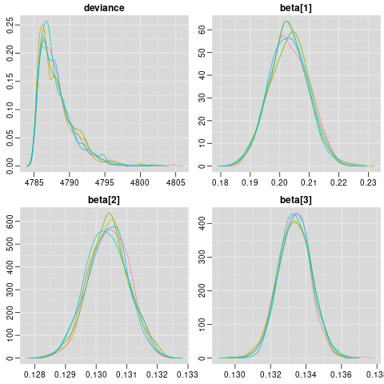
Luxemburg
7DMA
Specify Exact Changepoints
2020-09-20
2021-01-15
Nice Convergence! No Autocorrelation

Slide 14
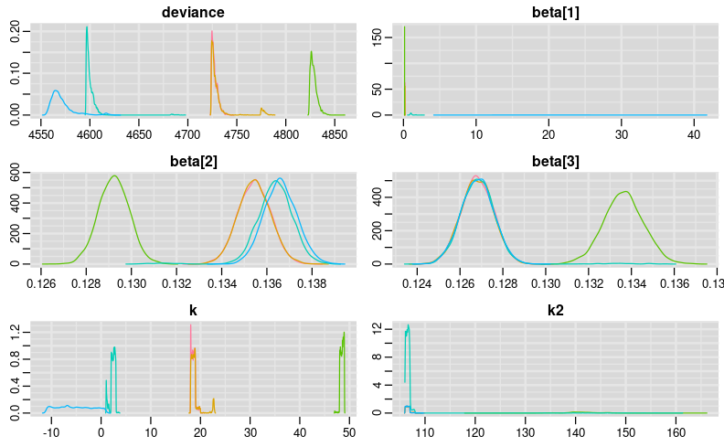
Luxemburg
7DMA
Estimate 2 Changepoints
250,000 iterations
5 chains
50 thin

Slide 15
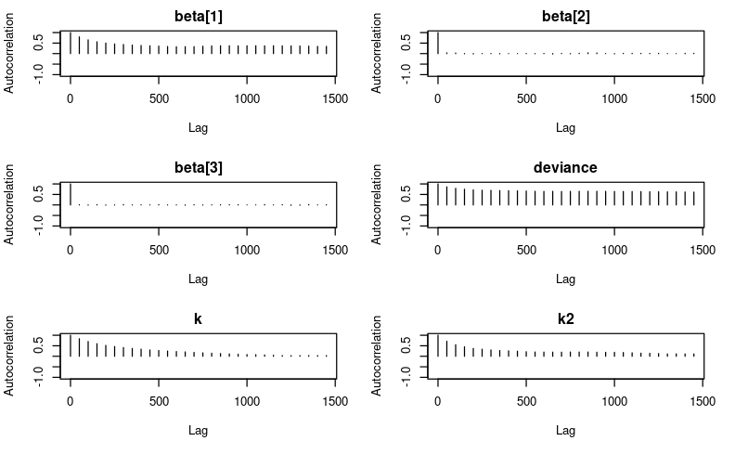
Luxemburg
Autocorrelation not so bad

Slide 16
Country | # Change points | pD | DIC | Beta μ (σ) | Κ
LU 7DMA | 0 | 1 | 4953 | 0.132(0.001) | NA
 | 1 | 2 | 4844 | 0.132 (0.001) 0.194 (0.007) | k = 19
 | 2 | 3 | 4788 | 0.130 (0.006) 0.133 (0.001) 0.203 (0.001) | k = 19 k2 = 136
 | 2 (est) | -244 | 4708 | 2.337 (3.8) 0.135 (0.002) 0.138 (0.001) | k = 16.3(19.7) k2=113(12.1)

Slide 17
Denmark
Population: 5.8 M
Max Cases: 3.7k

Slide 18
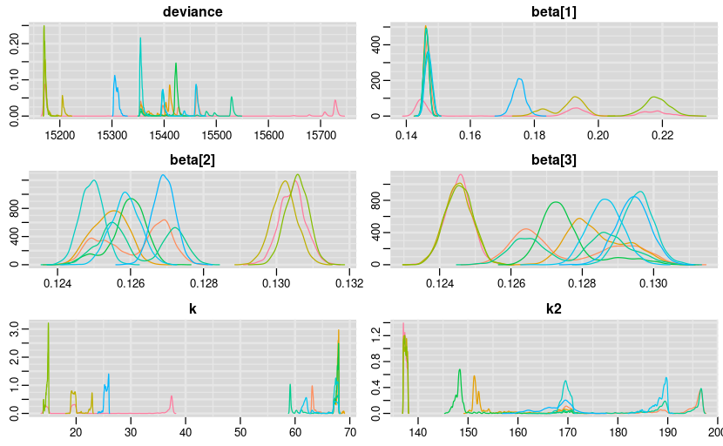
Denmark
Population: 5.8 M
Max Cases: 3.7k

Slide 19
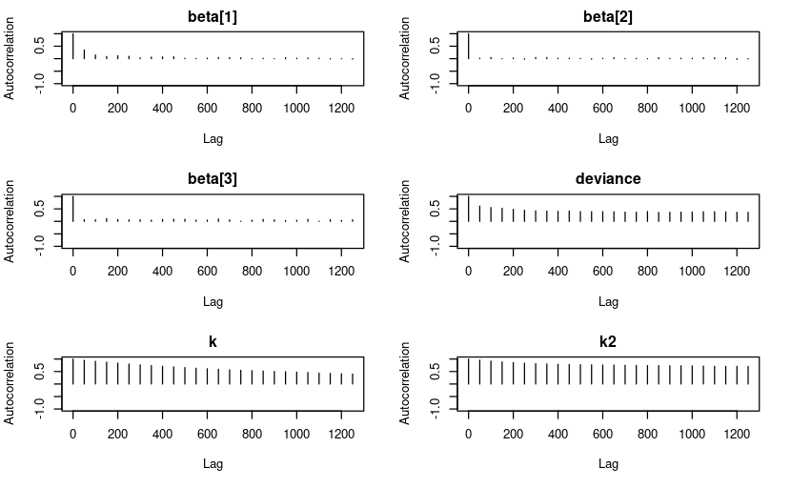
Denmark
Population: 5.8 M
Max Cases: 3.7k

Slide 20
Country | # Change points | pD | DIC | Beta μ (σ) | Κ
DK 7DMA | 0 | 1 | 16043 | 0.129 (0.0) | NA
 | 1 | 2 | 15666 | 0.126 (0.0) 0.138 (0.0) | k = 44
 | 2 | 3 | 15595 | 0.125 (0.0) 0.129 (0.0) 0.139 (0.0) | k = 44 k2 = 167
 | 2 (est) | -506 | 15210 | 0.123 (0.001) 0.128 (0.002) 0.140 (0.001) | k = 95.2 (6.8) k2=155.3(7.5)

Slide 21
MCMC Simulation
Οποιος δεν έχει μυαλό έχει πόδια.
Do we need a lot of iterations to converge? Or do we just need a better formulation of the problem?
Does existence of change points contradict our MCMC’s markovian stationarity assumption?

Slide 22
Changepoint methodology
How well, and how generally, can we detect change-points? Is there a way to do so without such strong prior ?
Can we estimate the NUMBER of change points, and where they are?
Online vs Historical Estimation ?
What if we have a lot more data ? DNA Sequence Change-points instead of covid cases?
Trend, Seasonality, Volatility Time Series Modeling vs State-Space Models.

Slide 23
Changepoint methodology
Procedure:
Smooth signal
Detect local maxima/minima (Approximate curvature ?) What is the use of approximating the function?
Hierarchical model, specify first-stage prior on number n changepoints, second-stage prior on the location of n changepoints ?
EM on changepoints, compare DICs, intractable ?

